Slide 1
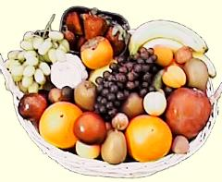
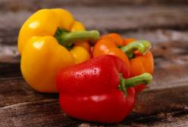
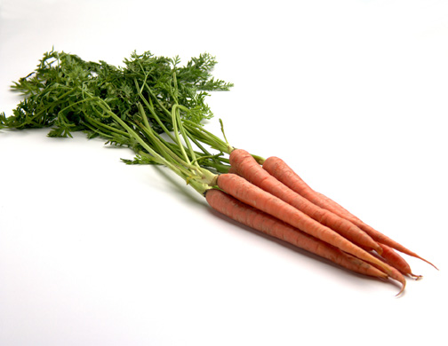
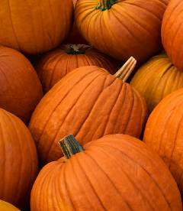

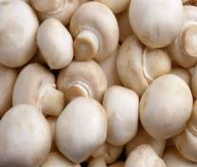


Fruit and Vegetables
Copyright of www.makemegenius.com, for more videos ,visit us.

Slide 2
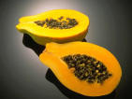
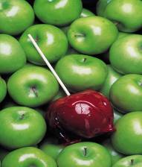
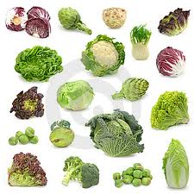

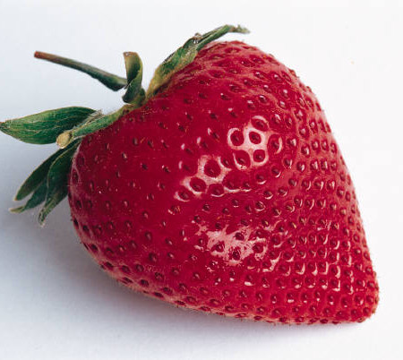
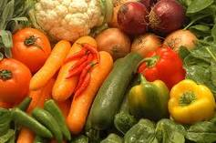
How many pieces of fruit and vegetables have you eaten today?
Why do you think we should eat fruit and vegetables?
To be healthier and live longer.
Copyright of www.makemegenius.com, for more videos ,visit us.

Slide 3

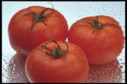
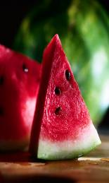
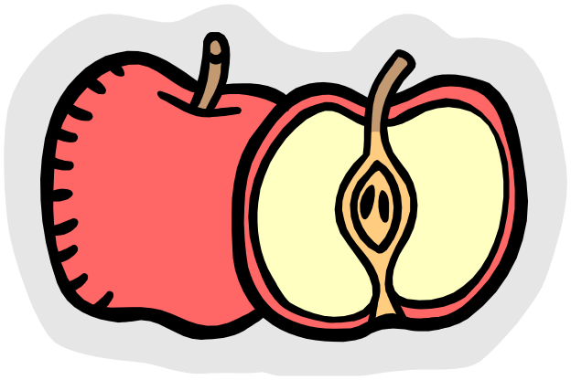
Can you name these fruit and vegetables?
tomato
lemon
banana
papaya
apple
water melon
Copyright of www.makemegenius.com, for more videos ,visit us.

Slide 4
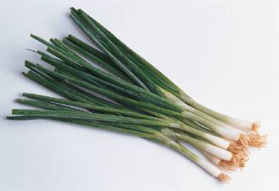
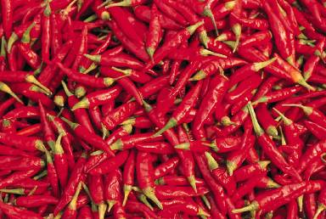

Now try naming these!
chili
Spring onion
coconut
Copyright of www.makemegenius.com, for more videos ,visit us.

Slide 5
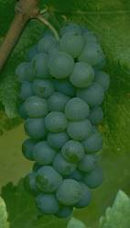
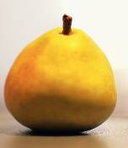
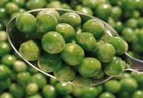
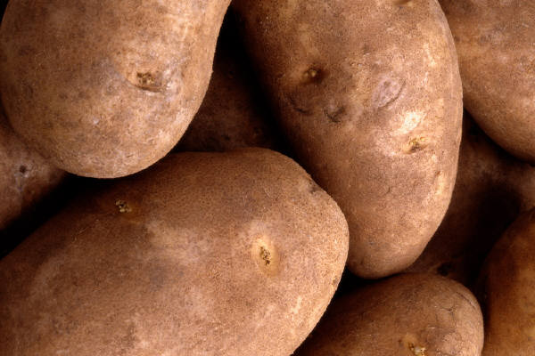
Healthy eating includes eating at least five portions of fruit and vegetables each day.
Fruit and vegetables contain vitamins and minerals, which keep our body healthy.
Fresh, frozen, tinned, or dried varieties of fruit and vegetables and fruit juice are all good for us.
Fruit and vegetables and fruit juices also contain lots of water and help stop you becoming dehydrated and feeling tired.
Copyright of www.makemegenius.com, for more videos ,visit us.

